Slide 1


Jeff Barlow-Spady
September 2024

Slide 2
Outline
Executive Summary
Introduction
Methodology
Results
Conclusion
Appendix

Slide 3
Executive Summary
Logistic Regression and SVM models show promising accuracy, enhancing prediction reliability.
Accurate landing predictions can lead to cost savings by enabling the reuse of rocket stages, impacting competitive bidding for launches.

Slide 4
Introduction
Project background and context
Space X advertises Falcon 9 rocket launches on its website with a cost of 62 million dollars; other providers cost upward of 165 million dollars each, much of the savings is because Space X can reuse the first stage. Therefore, if we can determine if the first stage will land, we can determine the cost of a launch. This information can be used if an alternate company wants to bid against space X for a rocket launch. This goal of the project is to create a machine learning pipeline to predict if the first stage will land successfully.
Problems you want to find answers
What factors determine if the rocket will land successfully?
The interaction amongst various features that determine the success rate of a successful landing.
What operating conditions needs to be in place to ensure a successful landing program.

Slide 5

Section 1

Slide 6
Methodology
Executive Summary
Data collection methodology
Perform exploratory data analysis (EDA) using visualization and SQL
Perform interactive visual analytics using Folium and Plotly Dash
Perform predictive analysis using classification models
Perform data wrangling

Slide 7
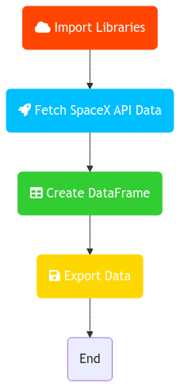
Data Collection – SpaceX API
Data was sourced from SpaceX's API, focusing on rocket launch metrics such as payload mass and landing outcomes
https://github.com/Jeff-Barlow-Spady/DS-NB/blob/master/notebooks/final/spacex_notebooks/jupyter-labs-spacex-data-collection-api%20(1).ipynb

Slide 8
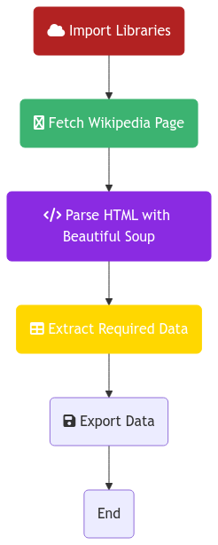
Data Collection - Scraping
Data was sourced from SpaceX’s wikipedia, focusing on rocket launch metrics such as payload mass and landing outcomes
https://github.com/Jeff-Barlow-Spady/DS-NB/blob/master/notebooks/final/spacex_notebooks/jupyter-labs-spacex-data-collection-api%20(1).ipynb

Slide 9
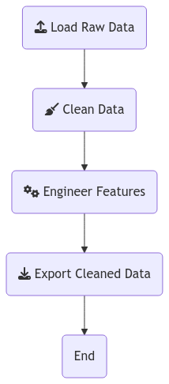
Data Wrangling
Utilized pandas for cleaning and preparing the data by handling missing values and transforming features
https://github.com/Jeff-Barlow-Spady/DS-NB/blob/master/notebooks/final/spacex_notebooks/labs-jupyter-spacex-Data%20wrangling.ipynb

Slide 10
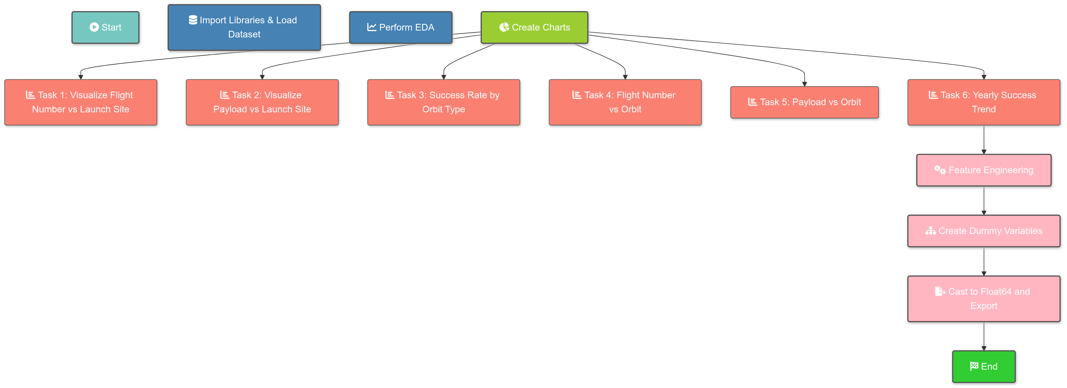
EDA with Data Visualization
https://github.com/Jeff-Barlow-Spady/DS-NB/blob/master/notebooks/final/spacex_notebooks/jupyter-labs-eda-dataviz.ipynb

Slide 11
EDA with SQL
[Task 1: Retrieve Unique Launch Sites];
[Task 2: Filter Launch Sites by Prefix];
[Task 3: Calculate Payload Mass for NASA];
[Task 4: Average Payload Mass for Booster v1.1];
[Task 5: First Successful Ground Landing Date];
[Task 6: Select Boosters with Criteria];
[Task 7: Successful vs Failed Missions];
[Task 8: Max Payload Mass Boosters];
[Task 9: Filter 2015 Failures by Month];
[Task 10: Rank Landing Outcomes];
https://github.com/Jeff-Barlow-Spady/DS-NB/blob/master/notebooks/final/spacex_notebooks/jupyter-labs-eda-sql-coursera_sqllite.ipynb

Slide 12

Build an Interactive Map with Folium
Functions from the Folium libraries are used to visualize the data through interactive maps.
The Folium library is used to:
Mark all launch sites on a map
Mark the succeeded launches and failed launches for each site on the map
Mark the distances between a launch site to its proximities such as the nearest city, railway, or highway

Slide 13

Build a Dashboard with Plotly Dash
Created an interactive, styled dashboard to communicate insights
Pie Chart With Success Rate For Launch Sites
Scatter chart showing the relationship with Outcome and Payload Mass (Kg) for the different booster version.

Slide 14
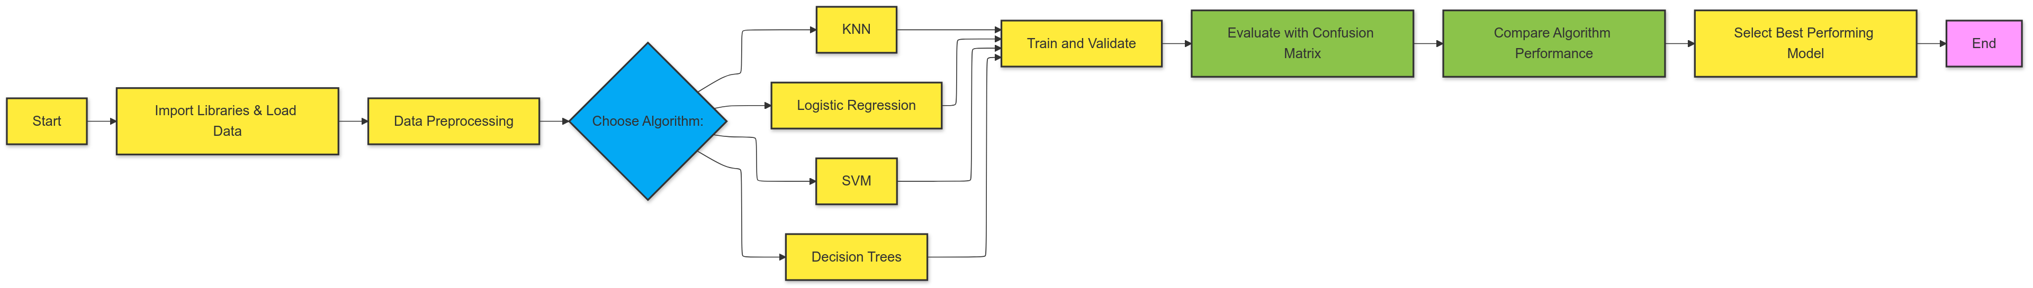
Predictive Analysis (Classification)
https://github.com/Jeff-Barlow-Spady/DS-NB/blob/master/notebooks/final/dash/spacex_dash_app%20(1).py

Slide 15
Results
Exploratory data analysis results
Interactive analytics demo in screenshots
Predictive analysis results

Slide 16

Section 2

Slide 17
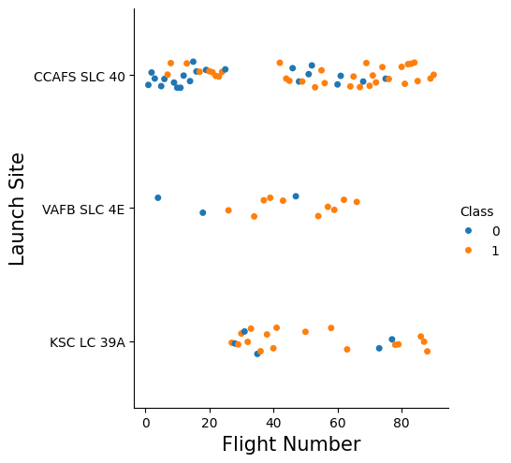
Flight Number vs. Launch Site
Chart demonstrating correlation between Flight Number and launchsite

Slide 18
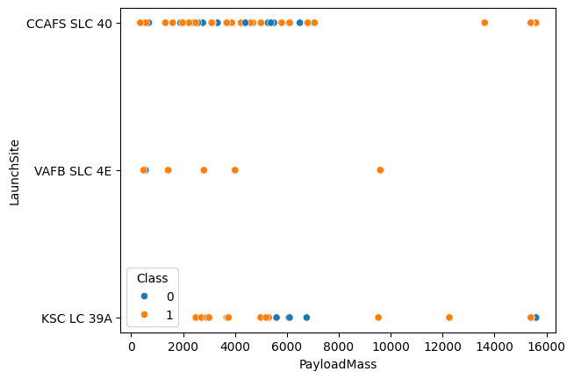
Payload vs. Launch Site
Relationship between launch site and payload size

Slide 19
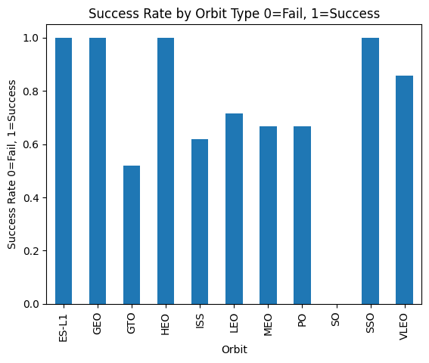
Success Rate vs. Orbit Type
ES-L1, GEO, ISS and SSO had the heightest success rate

Slide 20
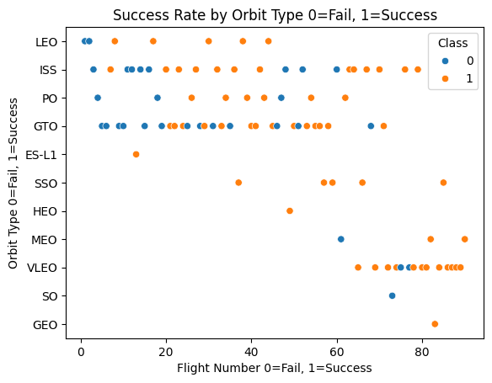
Flight Number vs. Orbit Type
Success rate by orbit type

Slide 21
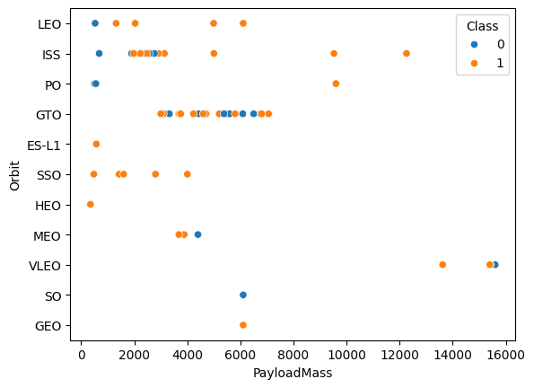
Payload vs. Orbit Type
Payload mass vs orbit type

Slide 22
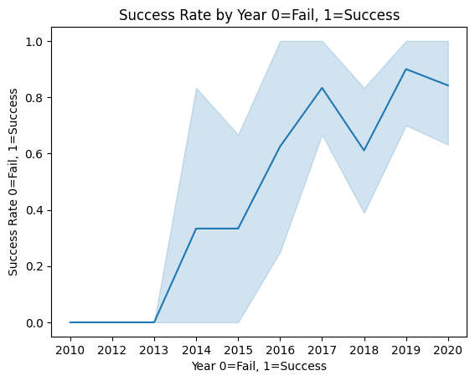
Launch Success Yearly Trend

Slide 23
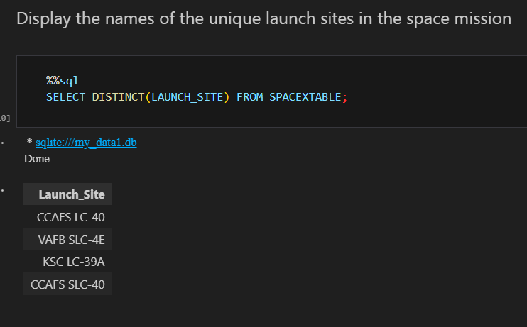
All Launch Site Names

Slide 24
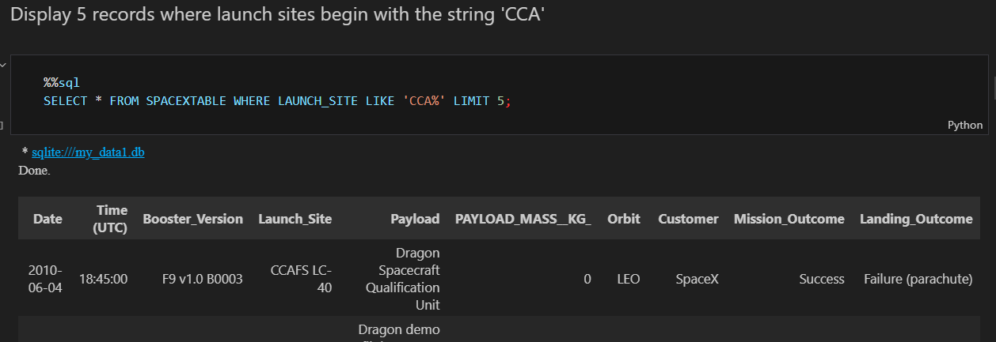
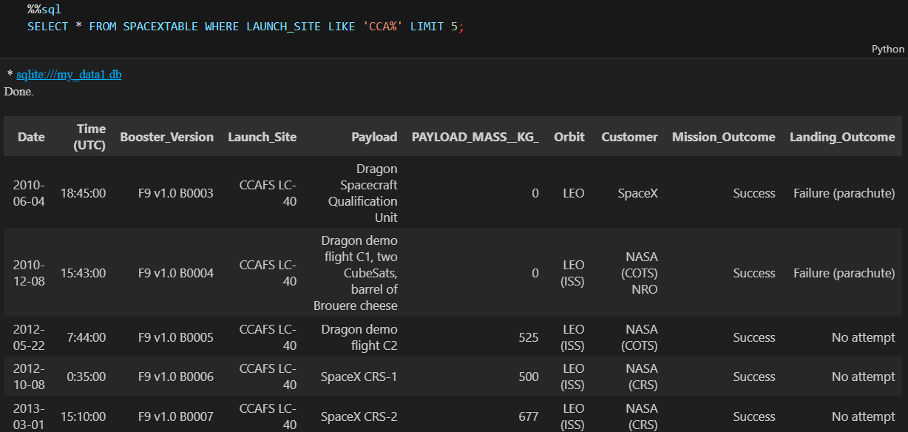
Launch Site Names Begin with 'CCA'

Slide 25
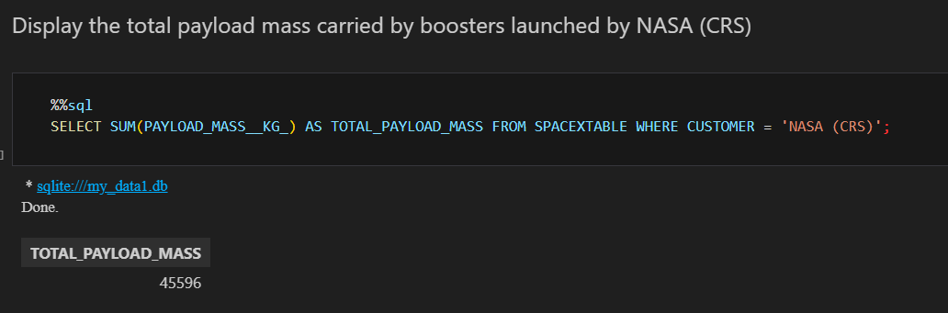
Total Payload Mass

Slide 26
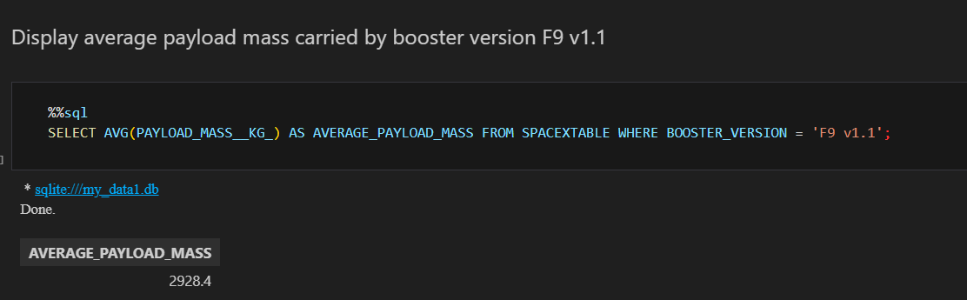
Average Payload Mass by F9 v1.1

Slide 27
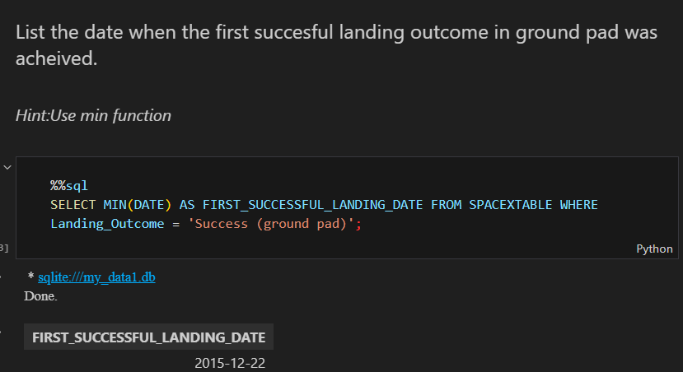
First Successful Ground Landing Date

Slide 28
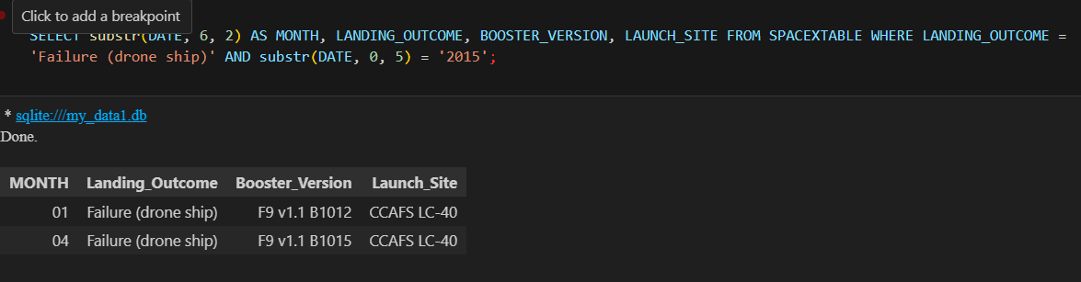
Successful Drone Ship Landing with Payload between 4000 and 6000

Slide 29
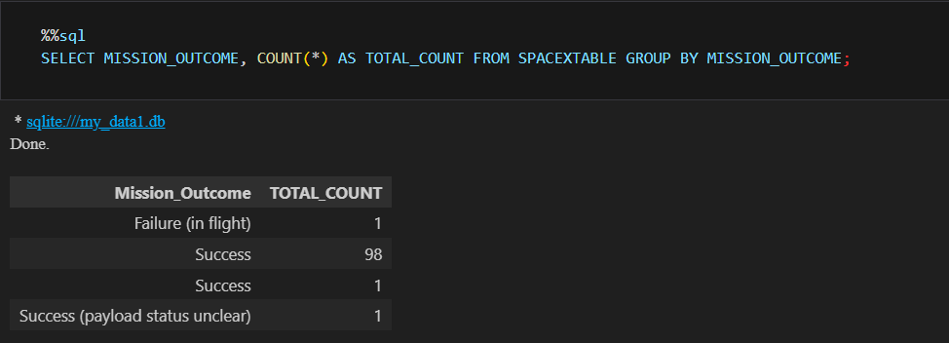
Total Number of Successful and Failure Mission Outcomes

Slide 30
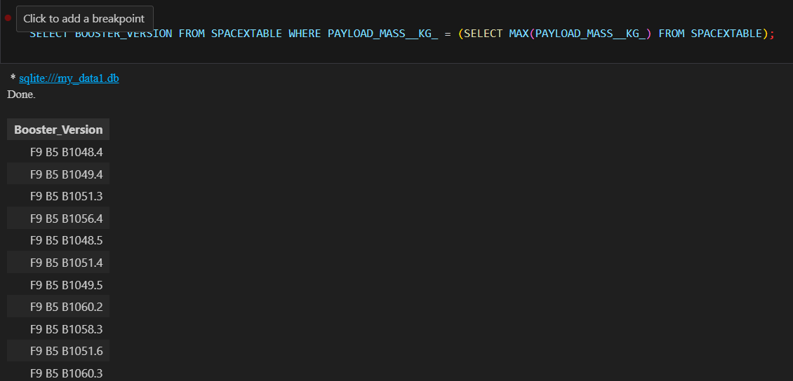
Boosters Carried Maximum Payload

Slide 31
2015 Launch Records

Slide 32
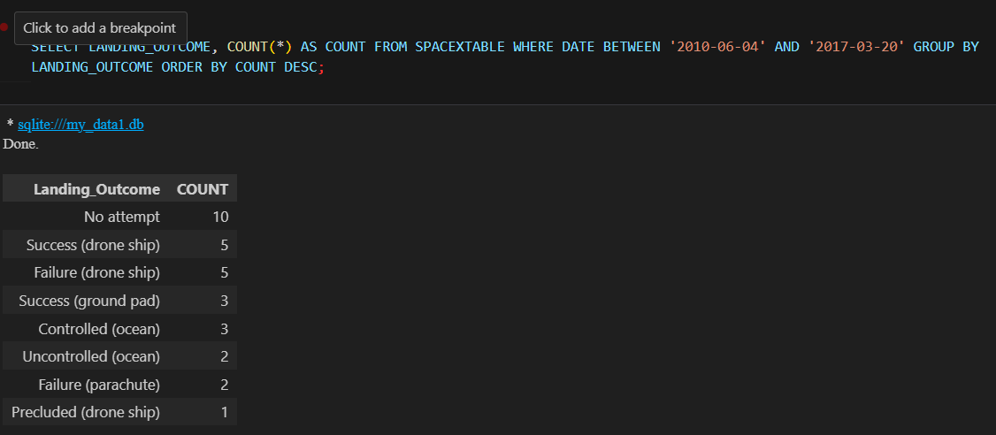
Rank Landing Outcomes Between 2010-06-04 and 2017-03-20

Slide 33

Section 3

Slide 34
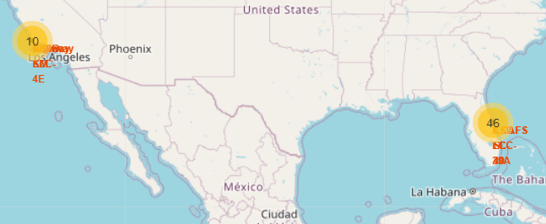
Wide View Showing marker clusters

Slide 35
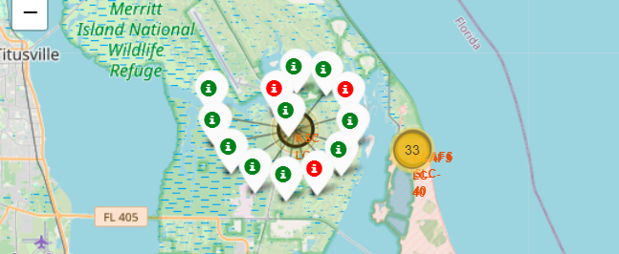
Outcome Class as Coloured Marker

Slide 36
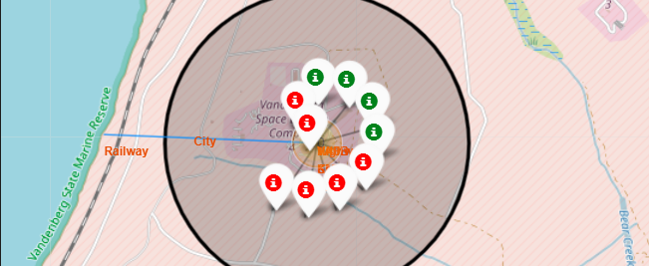
Example of folium annotations

Slide 37

Section 4

Slide 38
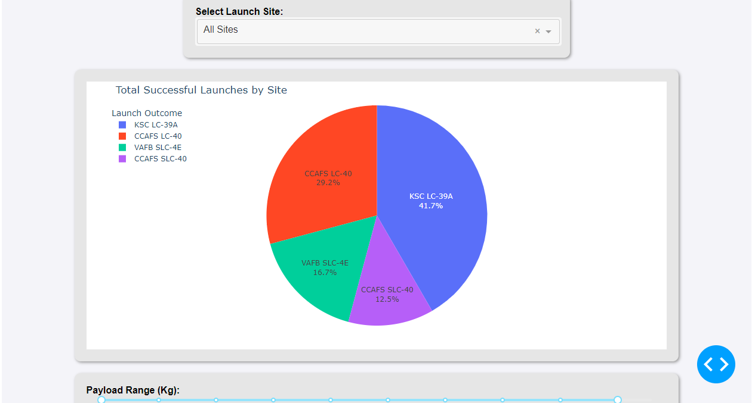
Launch Sites
dash script

Slide 39
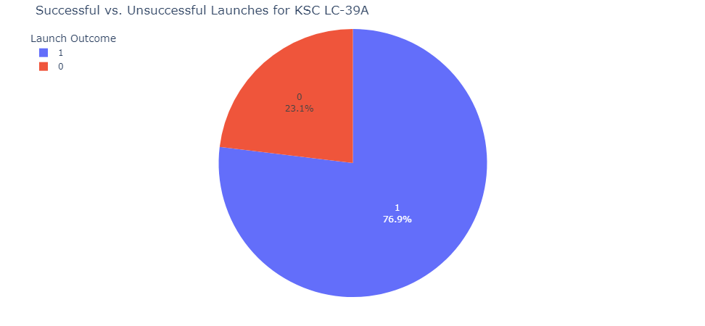
Highest Success Ratio
dash script

Slide 40
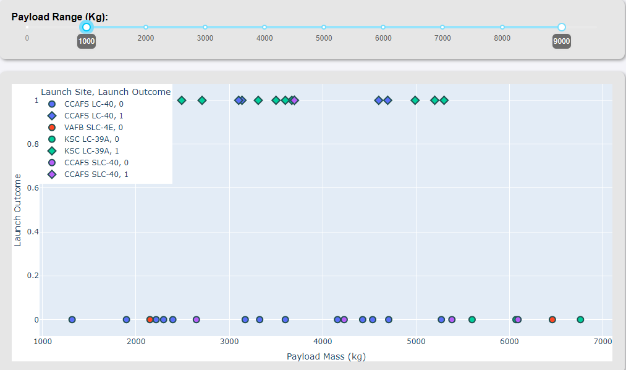
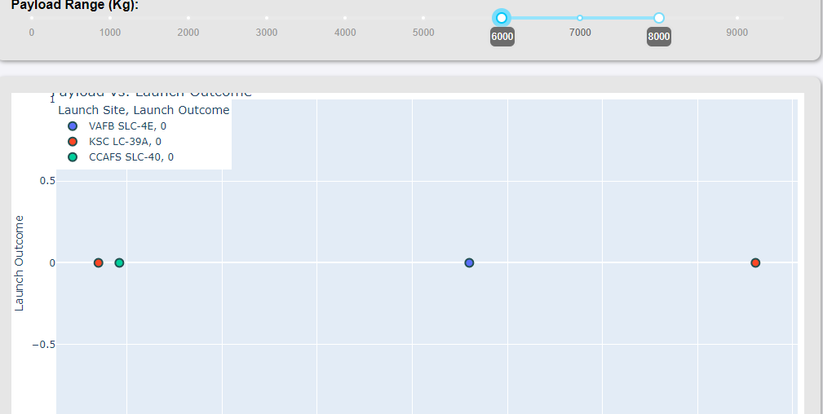
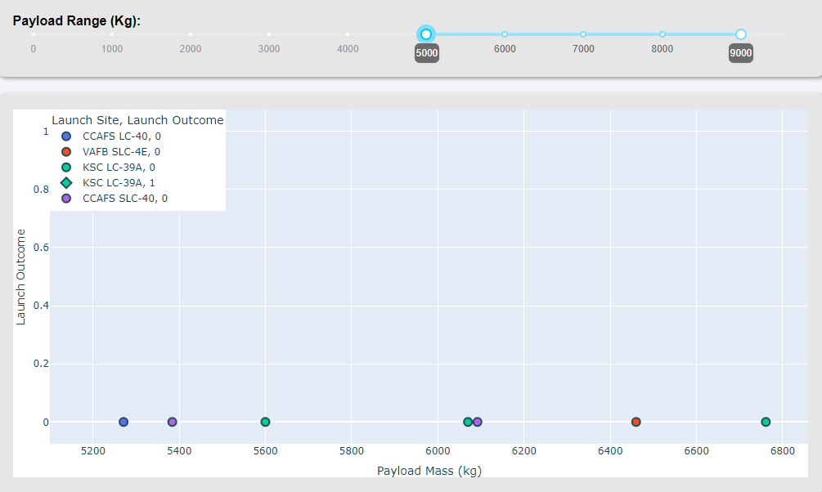
Payload vs Launch Outcome
dash script

Slide 41

Section 5

Slide 42
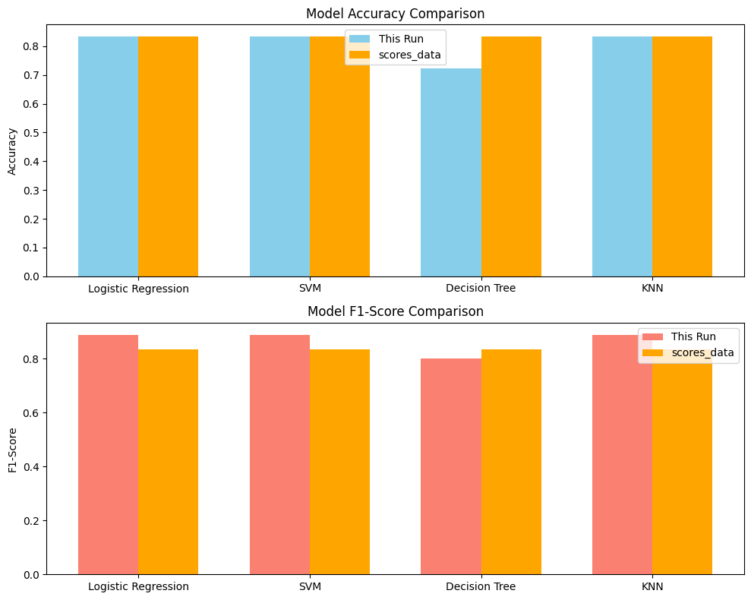
Classification Accuracy
notebook link

Slide 43
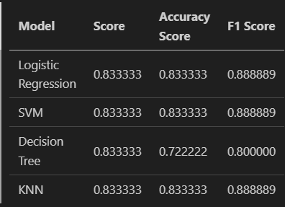

Confusion Matrix
Logistic Regression, SVM and KNN had the same scores

Slide 44
Conclusions
The models achieved high accuracy in predicting Falcon 9 landings, showcasing the effectiveness of data-driven approaches in aerospace.
Accurate predictions can significantly reduce launch costs, enhancing SpaceX's competitive edge and enabling informed decision-making.
Hyperparameter tuning optimized model performance, underscoring the value of rigorous model development processes.
Future enhancements could involve advanced techniques and feature enrichment to further improve predictions and practical applications.
notebook link

Slide 45


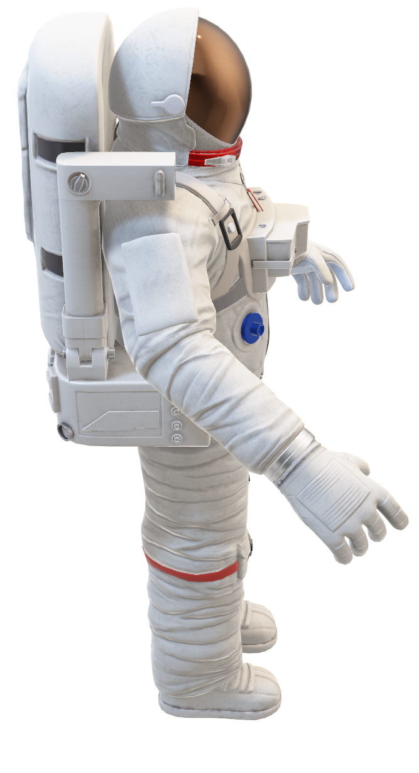
Appendix
Visit My Github
YOU

Slide 46


